Slide 2
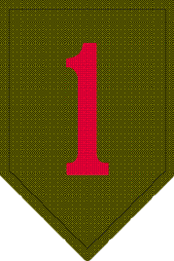
30 December 2009
Dear Soldier,
It is my distinct pleasure to officially welcome you to the 701st Brigade Support Battalion (BSB).
We are excited about the future of our great organization as part of one of the newest units in the Army, the 4th Infantry Brigade Combat Team (IBCT), 1st Infantry Division. I know you will find your assignment professionally and personally rewarding.
The 701st BSB’s mission is to provide tactical multifunctional logistics service. This battalion has key roles in the Army Transformation and the Global War on Terrorism. The battalion is comprised of eight companies which will provide direct support to the 4th IBCT.
We have some of the best trained and most professional officers, NCOs, and Soldiers that are proud of what they do and take the upmost pride in serving in America’s “Big Red One,” the oldest division in the Army. We look forward to adding you, your capabilities and your family to our team. Show up ready. Be physically, mentally, and spiritually prepared to accept the challenges of standing up a new Battalion. Expect your first few months to be focused on challenging METL based training, new equipment, and the fielding of new equipment.
In closing, I don’t have to remind you that it takes special people to be part of today’s professional military. You should be proud of yourself for serving during such a critical and important time in America’s history. Thank you for your continued dedication to, and support of our National and military.
Get After It!!!
(First Mi. Last) (First Mi. Last)
Rank, Branch Rank, Branch
Battalion Command Sergeant Major Commanding

